Slide 1

MELBOURNE HOUSING ANALYSIS

Slide 2
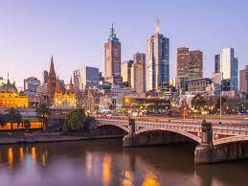
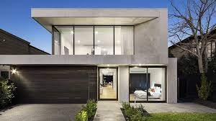
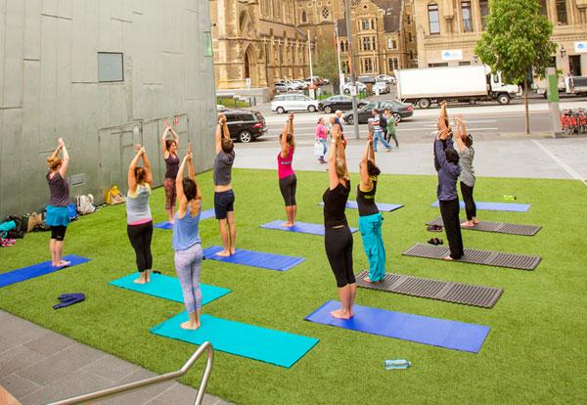
Overview
2ND MOST LIVEABLE CITY IN THE WORLD
REAL ESTATE ONE OF THE BEST PERFORMING INDUSTRIES IN AUSTRALIA
CITY OF INDEPENDENT YOUTH WHO MAKE UPTO 64% OF TOTAL POPULATION

Slide 3
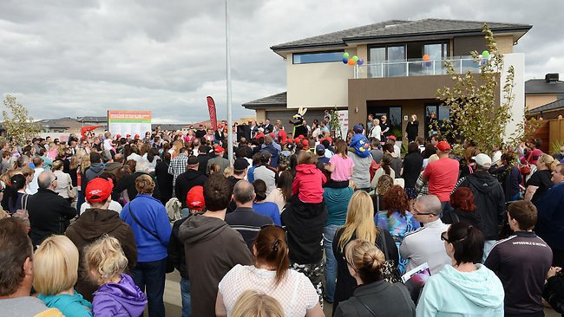
The Housing Situation
High demand for Houses.
Houses are sold through auction and direct sale.
Prices are skyrocketing.
Property is becoming more and more unaffordable.
Home ownership rates for people under age 40 is declining.

Slide 4
Housing Problem
Failure by the housing system to provide the right:
Quantity of houses,
With the right characteristics,
The right locations overtime.
The research seeks to understand house market demand
by analysing housing sales data.

Slide 5
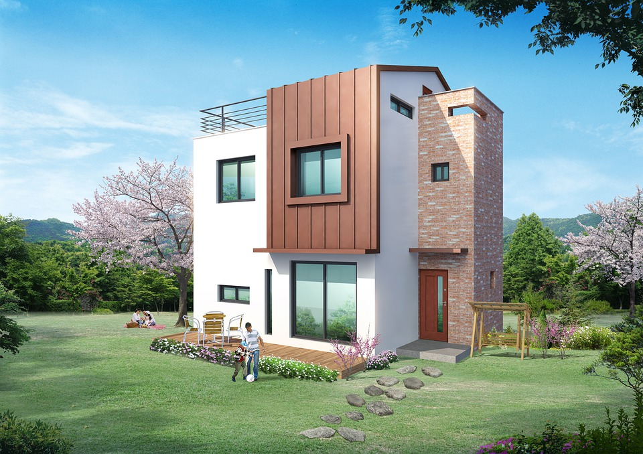
Objectives
House Type
Location
Property Features
Houses
Units
Townhouses
Regions
Council Area
Suburb
Distance from CBD
Rooms
Bedrooms
Bathrooms
Land size
Parking Space

Slide 6
Data Description
Dataset : Melbourne housing sales dataset
Source : Domain Group
Characteristics:
Period : May 2016 - March 2018
Shape: 21 x 34856
Columns:
Type
Price
Suburb
e.t.c

Slide 7
Data Cleaning
Dropping Irrelevant Columns
Renaming Columns
Check and dropping duplicates
Check for outliers
Change data types
Check for null values
Filled price and land size with median
Filled the rest with 0

Slide 8
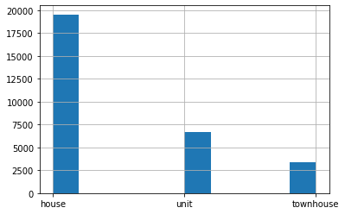
Analysis
TYPE OF PROPERTY
House 19548
Unit 6713
Townhouse 3413

Slide 9
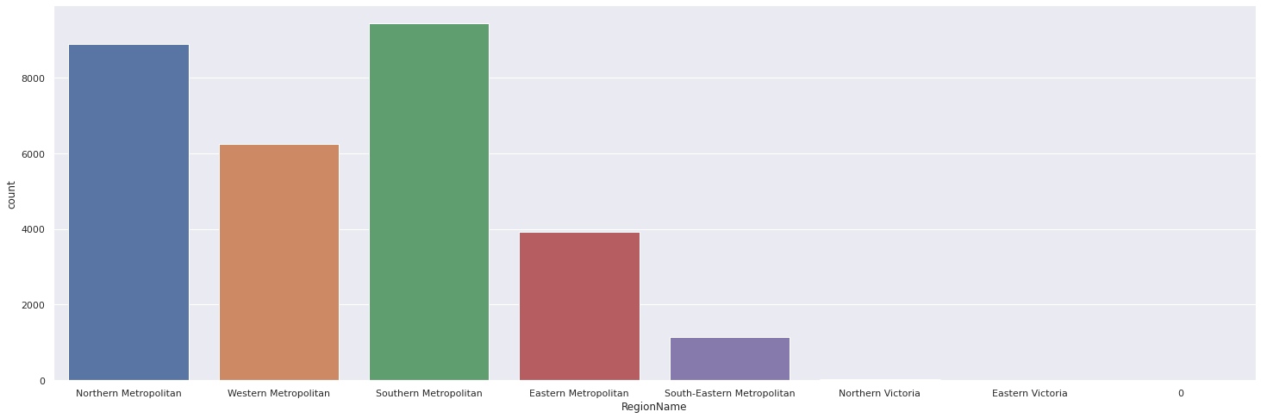
Location
By Region
Southern Metropolitan 9428
Northern Metropolitan 8892
Western Metropolitan 6245

Slide 10
Location
Council Area
Suburb
Darebin City Council 2730
Boroondara City Council 2555
Moreland City Council 2028
Glen Eira City Council 1837
Banyule City Council 1710
Reservoir 829
Bentleigh East 571
Richmond 498
Preston 473
Brunswick 421

Slide 11
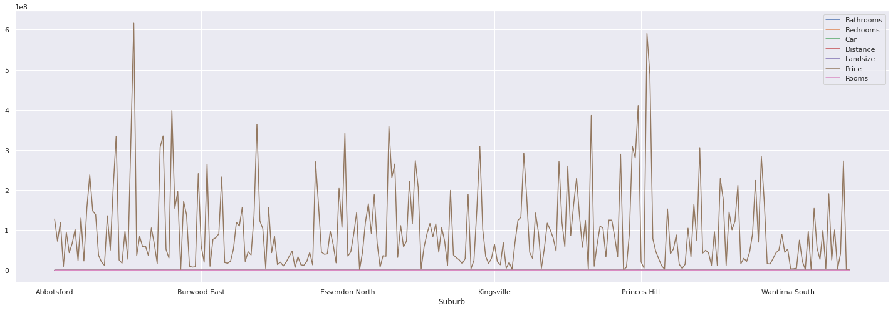
Property Features
High positive correlation between property features and price

Slide 12
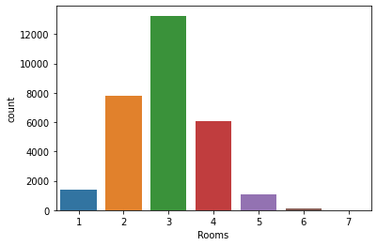
Popularity by Rooms
Notes:
What are the most popular rooms? 3 13251
Three-bedroom houses are the most popular
Houses with one bathroom are the most popular
What is the most popular number of parking spaces? 2 9870

Slide 13
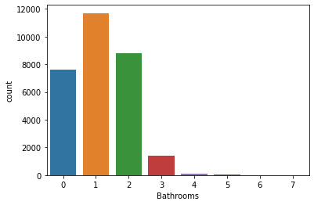
Popularity by Bathrooms
Notes:
What are the most popular rooms? 3 13251
Three-bedroom houses are the most popular
Houses with one bathroom are the most popular
What is the most popular number of parking spaces? 2 9870

Slide 14
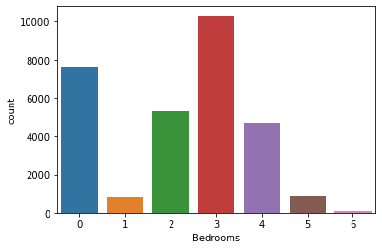
Popularity by Bedrooms
Notes:
What are the most popular rooms? 3 13251
Three-bedroom houses are the most popular
Houses with one bathroom are the most popular
What is the most popular number of parking spaces? 2 9870

Slide 15
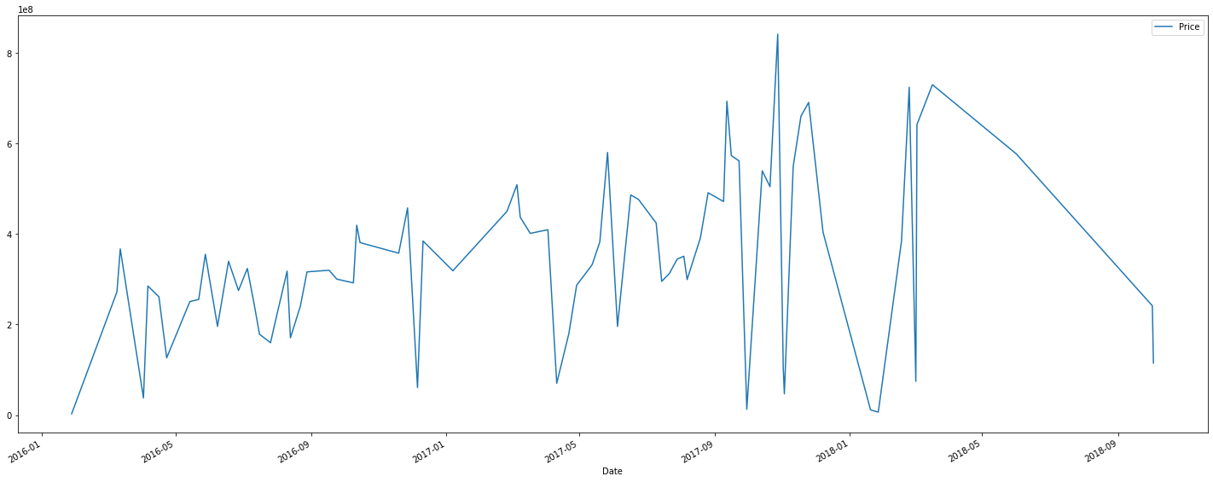
Changes in Price over Time
Notes:
There are monthly fluctuations but generally, the price has been on an upward trend

Slide 16
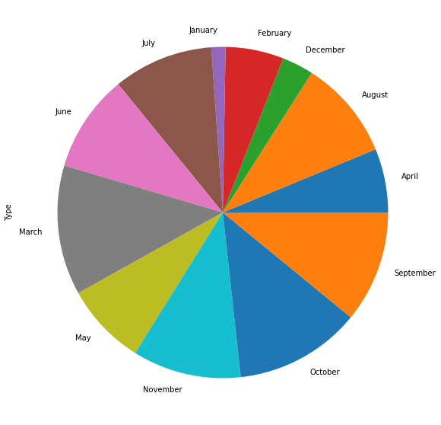
Sale per Month
March 3758
October 3665
September 3237
November 3153
July 2904

Slide 17
Recommendations
Investors should focus in the most popular characteristics of a property to meet market demand.
Invest in the right kinds of property.

Slide 18
Breakdown of the Solution
Property Features
Location of Property
Type
3 Rooms
3 Bedrooms
2 Parkings Slots
1 Bathroom
Region
Southern Metropolitan
Northern Metropolitan
Council Area
Darebin City Council
Boroondara City Council
Suburb
Reservoir
Bentleigh East
House 65.94%
Unit 22.64%
Town House 11.51%

Slide 19
Q & A

Slide 20
Analysis by:
Women in Tech

